Slide 1


Typical States of a Supersymmetric Black Hole With Finite Area
Relatore
prof. Stefano Giusto​
Correlatore
prof. Nicola Maggiore
Candidato
Riccardo Banzi
Genova, 28/10/2021

Slide 2
Introduction
Main topics of the thesis
Theoretical problems regarding black holes
1/25

Slide 3
Introduction
Main topics of the thesis
Theoretical problems regarding black holes
MICROSTATE PROBLEM
INFORMATION PARADOX
1/25

Slide 4

Introduction
Main topics of the thesis
Theoretical problems regarding black holes
MICROSTATE PROBLEM
INFORMATION PARADOX
Proposed solution
FUZZBALL CONJECTURE
1/25

Slide 5
Introduction
Main topics of the thesis
Theoretical problems regarding black holes
MICROSTATE PROBLEM
INFORMATION PARADOX
Proposed solution
FUZZBALL CONJECTURE
Aim of the thesis: investigating the conjecture further
1/25

Slide 6
Introduction
Summary of the presentation
5 parts
2/25

Slide 7
Introduction
Summary of the presentation
5 parts
1. THEORETICAL PROBLEMS
2/25

Slide 8
Introduction
Summary of the presentation
5 parts
1. THEORETICAL PROBLEMS
2. THE FUZZBALL CONJECTURE
2/25

Slide 9
Introduction
Summary of the presentation
5 parts
1. THEORETICAL PROBLEMS
2. THE FUZZBALL CONJECTURE
3. HOLOGRAPHY
2/25

Slide 10
Introduction
Summary of the presentation
5 parts
1. THEORETICAL PROBLEMS
2. THE FUZZBALL CONJECTURE
3. HOLOGRAPHY
4. ORIGINAL CONTRIBUTION
2/25

Slide 11
Introduction
Summary of the presentation
5 parts
1. THEORETICAL PROBLEMS
2. THE FUZZBALL CONJECTURE
3. HOLOGRAPHY
4. ORIGINAL CONTRIBUTION
5. FUTURE DEVELOPMENTS
2/25

Slide 12
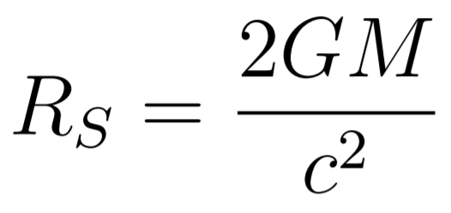
Theoretical Problems
What is a black hole?
Created by squeezing mass
Schwarzschild radius
3/25

Slide 13
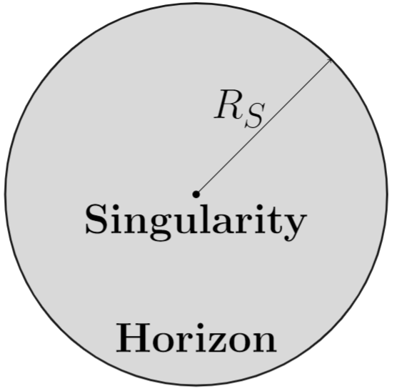
Theoretical Problems
What is a black hole?
Created by squeezing mass
Schwarzschild radius
Characteristics
Event Horizon: Point of no return.
Singularity: The mass is concentrated here.
3/25

Slide 14
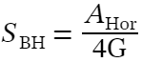
Theoretical Problems
Entropy
Black holes can be assigned entropy
Bekenstein-Hawking entropy
4/25

Slide 15
Theoretical Problems
Entropy
Black holes can be assigned entropy
Bekenstein-Hawking entropy
Must have some statistical significance
4/25

Slide 16
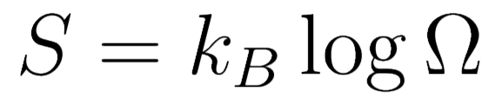
Theoretical Problems
Entropy
Black holes can be assigned entropy
Bekenstein-Hawking entropy
Must have some statistical significance
Ω=Microstates corresponding to M,Q,J
4/25

Slide 17
Theoretical Problems
Entropy
Black holes can be assigned entropy
Bekenstein-Hawking entropy
Must have some statistical significance
Ω=Microstates corresponding to M,Q,J
Ω=10^10^99 for solar mass black holes
4/25

Slide 18
Theoretical Problems
The microstate problem
Where are the typical microstates?
5/25

Slide 19
Theoretical Problems
The microstate problem
Where are the typical microstates?
?
Microstates
Metrics
5/25

Slide 20
Theoretical Problems
The microstate problem
Where are the typical microstates?
?
Microstates
Metrics
Microstate problem: Ω=1 due to uniqueness theorems
5/25

Slide 21
Theoretical Problems
The microstate problem
Where are the typical microstates?
?
Microstates
Metrics
Microstate problem: Ω=1 due to uniqueness theorems
Where is information stored?
Information paradox: the horizon deletes information
5/25

Slide 22
The Fuzzball Conjecture
Why String Theory?
QM is needed to describe microstates
6/25

Slide 23
The Fuzzball Conjecture
Why String Theory?
QM is needed to describe microstates
Therefore, both GR and QM are involved
6/25

Slide 24
The Fuzzball Conjecture
Why String Theory?
QM is needed to describe microstates
Therefore, both GR and QM are involved
Possible framework: String Theory
6/25

Slide 25
The Fuzzball Conjecture
Strings and Dp-branes
Strings: Replace point particles
7/25

Slide 26
The Fuzzball Conjecture
Strings and Dp-branes
Strings: Replace point particles
Open strings' endpoints obey Dirichlet boundary conditions
7/25

Slide 27
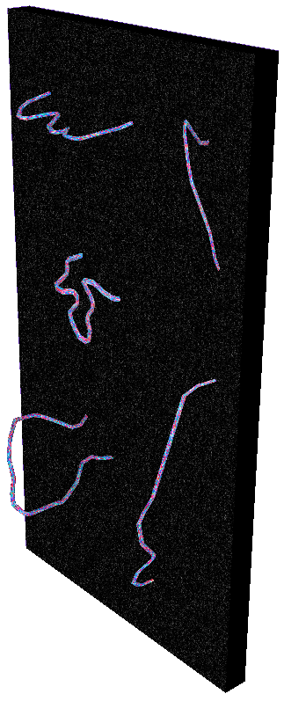
The Fuzzball Conjecture
Strings and Dp-branes
Strings: Replace point particles
Open strings' endpoints obey Dirichlet boundary conditions
The endpoints move inside Dp-branes
Ex: A D2-brane
7/25

Slide 28
The Fuzzball Conjecture
Extra dimensions
D=10 in string theory
8/25

Slide 29
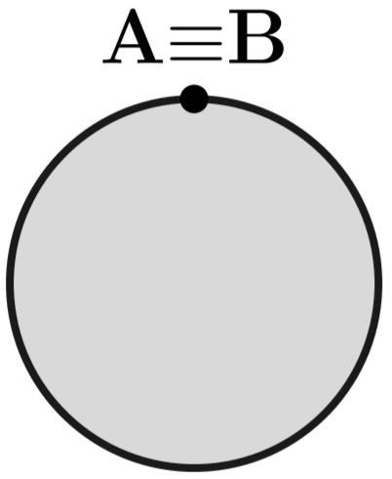

The Fuzzball Conjecture
Extra dimensions
D=10 in string theory
Extra spatial dimensions can be compactified
8/25

Slide 30
The Fuzzball Conjecture
Extra dimensions
D=10 in string theory
Extra spatial dimensions can be compactified
Supergravity: low-energy limit
8/25

Slide 31
The Fuzzball Conjecture
The D1-D5-P system
Describes a black hole in String Theory
5 dimensions compactified into S₁xT₄
9/25

Slide 32
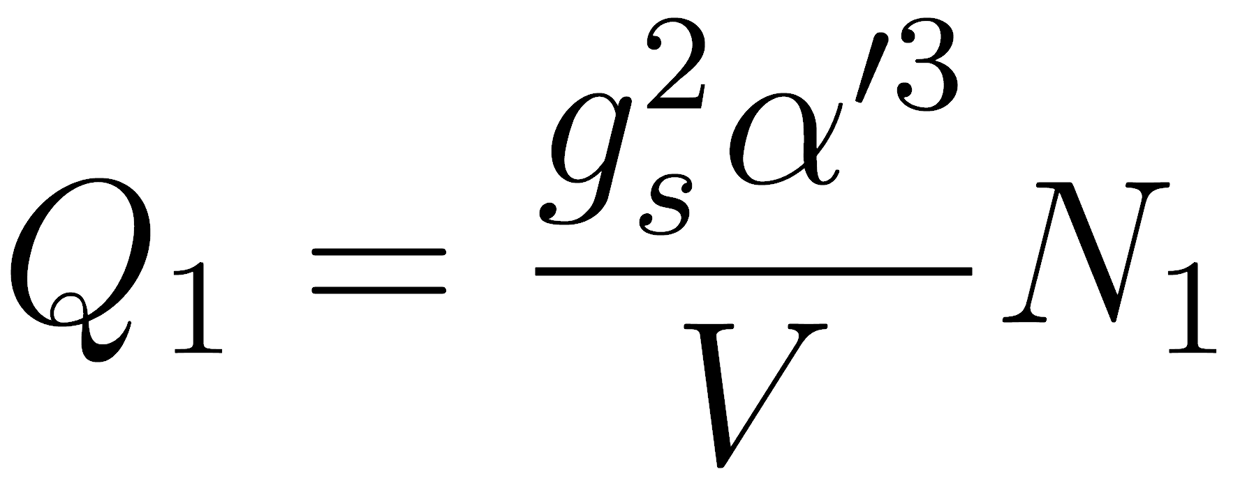
The Fuzzball Conjecture
The D1-D5-P system
Describes a black hole in String Theory
5 dimensions compactified into S₁xT₄
The system contains:
A D1-brane, electric charge Q₁, wrapped N₁ times along S₁
9/25

Slide 33

The Fuzzball Conjecture
The D1-D5-P system
Describes a black hole in String Theory
5 dimensions compactified into S₁xT₄
The system contains:
A D1-brane, electric charge Q₁, wrapped N₁ times along S₁
A D5-brane, magnetic charge Q₅, wrapped N₅ times along S₁xT₄
9/25

Slide 34
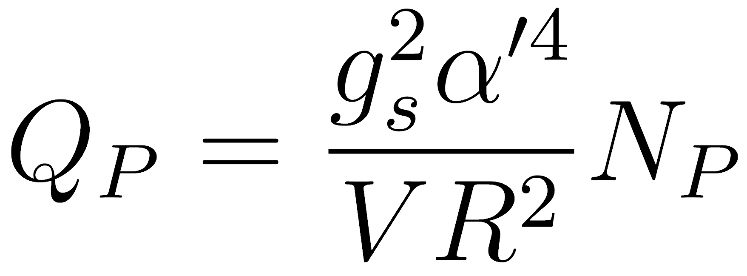
The Fuzzball Conjecture
The D1-D5-P system
Describes a black hole in String Theory
5 dimensions compactified into S₁xT₄
The system contains:
A D1-brane, electric charge Q₁, wrapped N₁ times along S₁
A D5-brane, magnetic charge Q₅, wrapped N₅ times along S₁xT₄
Momentum charge Q_{P}
9/25

Slide 35
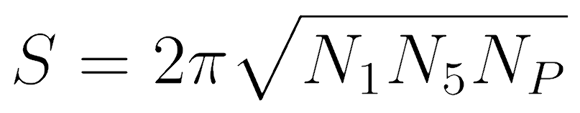
The Fuzzball Conjecture
Entropy
Entropy produced by the D1-D5-P system:
N₁,N₅,N_{P}→∞
10/25

Slide 36
The Fuzzball Conjecture
Entropy
Entropy produced by the D1-D5-P system:
N₁,N₅,N_{P}→∞
Supergravity
Microscopic
10/25

Slide 37
The Fuzzball Conjecture
Entropy
Entropy produced by the D1-D5-P system:
N₁,N₅,N_{P}→∞
Supergravity
Microscopic
Problem: What do microstates look like?
10/25

Slide 38
The Fuzzball Conjecture
Fuzzballs
Answer: Fuzzball conjecture (Mathur, Lunin)
11/25

Slide 39
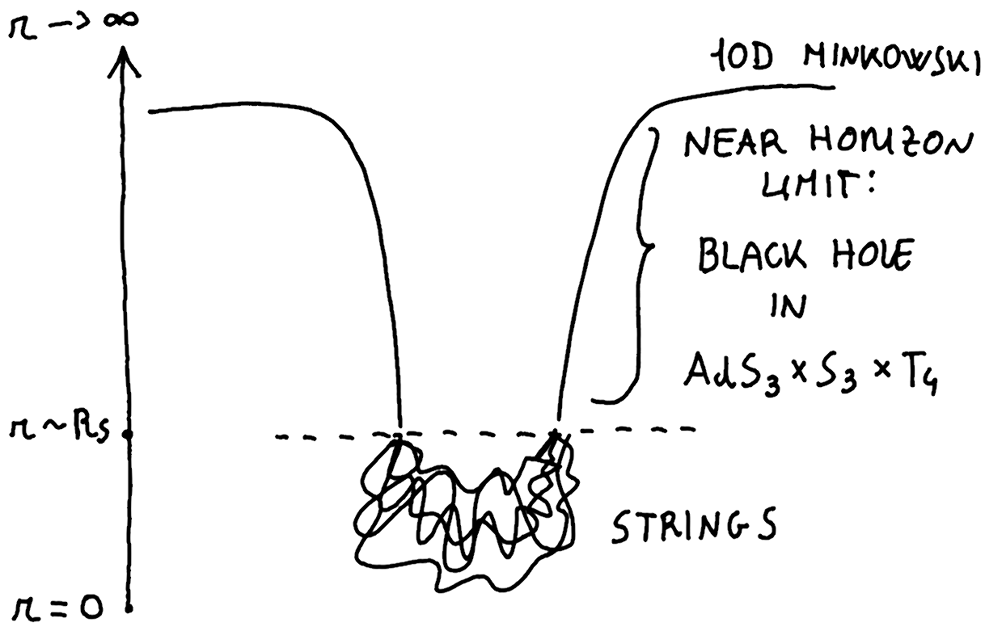
The Fuzzball Conjecture
Fuzzballs
Answer: Fuzzball conjecture (Mathur, Lunin)
General structure of a fuzzball solution:
[S.D. Mathur. The fuzzball proposal for black holes: an elementary review. Fortschritte der
Physik, 53(7-8):793-827, Jul 2005]
11/25

Slide 40
The Fuzzball Conjecture
Fuzzballs
Answer: Fuzzball conjecture (Mathur, Lunin)
General structure of a fuzzball solution:
Correct entropy for r~R_{S}
[S.D. Mathur. The fuzzball proposal for black holes: an elementary review. Fortschritte der
Physik, 53(7-8):793-827, Jul 2005]
11/25

Slide 41
The Fuzzball Conjecture
Fuzzballs
Answer: Fuzzball conjecture (Mathur, Lunin)
General structure of a fuzzball solution:
Correct entropy for r~R_{S}
Solves theoretical problems
[S.D. Mathur. The fuzzball proposal for black holes: an elementary review. Fortschritte der
Physik, 53(7-8):793-827, Jul 2005]
11/25

Slide 42
The Fuzzball Conjecture
Fuzzballs
Answer: Fuzzball conjecture (Mathur, Lunin)
General structure of a fuzzball solution:
Correct entropy for r~R_{S}
Solves theoretical problems
Aim: Find a new class of microstates
[S.D. Mathur. The fuzzball proposal for black holes: an elementary review. Fortschritte der
Physik, 53(7-8):793-827, Jul 2005]
11/25

Slide 43
Holography
AdS/CFT
AdS₃ factor in the Near Horizon Limit: AdS/CFT conjecture
12/25

Slide 44
Holography
AdS/CFT
AdS₃ factor in the Near Horizon Limit: AdS/CFT conjecture
String theory on AdS_{D} spacetime
(D-1)-dimensional CFT on the boundary
CFT=QFT+Conformal Invariance (Angles preserved)
12/25

Slide 45
Holography
AdS/CFT
AdS₃ factor in the Near Horizon Limit: AdS/CFT conjecture
String theory on AdS_{D} spacetime
(D-1)-dimensional CFT on the boundary
CFT=QFT+Conformal Invariance (Angles preserved)
Useful guide to represent microstates on gravity side
12/25

Slide 46
Holography
AdS/CFT
AdS₃ factor in the Near Horizon Limit: AdS/CFT conjecture
String theory on AdS_{D} spacetime
(D-1)-dimensional CFT on the boundary
CFT=QFT+Conformal Invariance (Angles preserved)
Useful guide to represent microstates on gravity side
Links strongly/weakly coupled theories
12/25

Slide 47
Holography
AdS/CFT
AdS₃ factor in the Near Horizon Limit: AdS/CFT conjecture
String theory on AdS_{D} spacetime
(D-1)-dimensional CFT on the boundary
CFT=QFT+Conformal Invariance (Angles preserved)
Useful guide to represent microstates on gravity side
Links strongly/weakly coupled theories
AdS₃xS₃xT₄
2D CFT: D1-D5 CFT
12/25

Slide 48
Holography
Studied system
The CFT can be visualized as N₁N₅ strings wrapped around S₁
13/25

Slide 49

Holography
Studied system
The CFT can be visualized as N₁N₅ strings wrapped around S₁
Ground state
AdS₃xS₃xT₄
13/25

Slide 50
Holography
Winding
Strings can be multiply wound
14/25

Slide 51
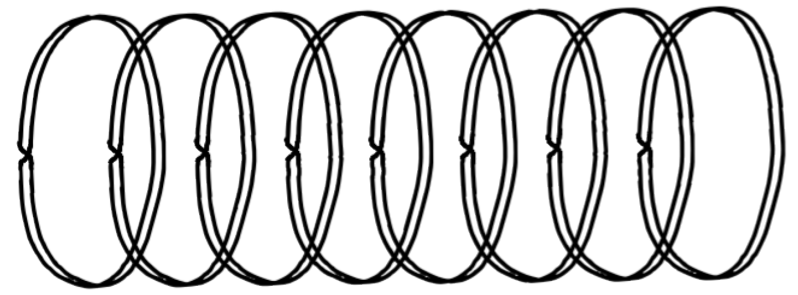
Holography
Winding
Strings can be multiply wound
N₁N₅=16
w=1
N₁N₅=16
w=2
14/25

Slide 52
Holography
Winding
Strings can be multiply wound
N₁N₅=16
w=1
N₁N₅=16
w=2
Limiting case: 1 string with w=N₁N₅
14/25

Slide 53
Holography
Momentum
The SU(2) operator J⁺_{-n} (n>0) adds n units of momentum
15/25

Slide 54


Holography
Momentum
The SU(2) operator J⁺_{-n} (n>0) adds n units of momentum
J⁺₋₁
=
15/25

Slide 55

Holography
Momentum
The SU(2) operator J⁺_{-n} (n>0) adds n units of momentum
J⁺₋₁
=
J⁺₋₂
=
15/25

Slide 56

Holography
Momentum
The SU(2) operator J⁺_{-n} (n>0) adds n units of momentum
J⁺₋₁
=
J⁺₋₂
=
J⁺₋₃
=
15/25

Slide 57

Holography
Momentum
The SU(2) operator J⁺_{-n} (n>0) adds n units of momentum
J⁺₋₁
=
J⁺₋₂
=
J⁺₋₃
=
J⁺₋₄
=
15/25

Slide 58
Holography
Momentum
We can act with multiple operators on a single string
16/25

Slide 59
Holography
Momentum
We can act with multiple operators on a single string
Example: string with 3 unities of momentum
J⁺₋₂J⁺₋₁
=
16/25

Slide 60
Holography
Momentum
We can act with multiple operators on a single string
Example: string with 3 unities of momentum
J⁺₋₂J⁺₋₁
=
Aim: Count these states
Does the system reproduce the correct entropy?
16/25

Slide 61
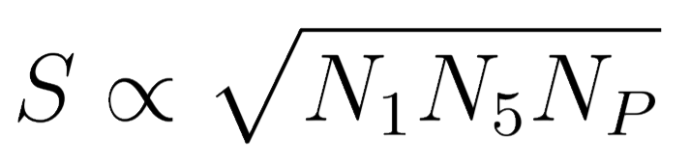
Original Contribution
Entropy
Winding w=1:
N₁,N₅,N_{P}→∞
N_{P}>>N₁N₅
17/25

Slide 62
Original Contribution
Entropy
Winding w=1:
N₁,N₅,N_{P}→∞
N_{P}>>N₁N₅
Winding w≈N₁N₅:
N₁,N₅,N_{P}→∞
17/25

Slide 63
Original Contribution
Microstates
Simple class obtained by acting with a symmetry on the ground state. w=1, J⁺₋₁ only, one at a time.
18/25

Slide 64
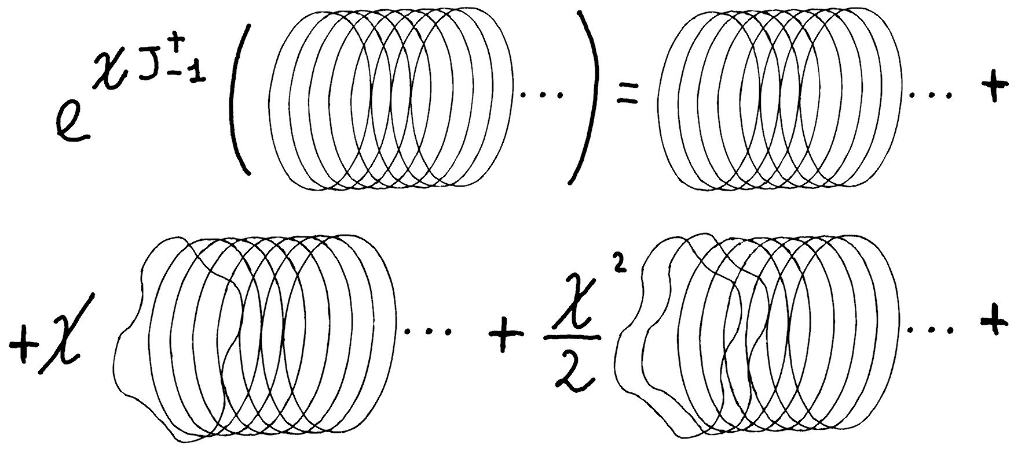
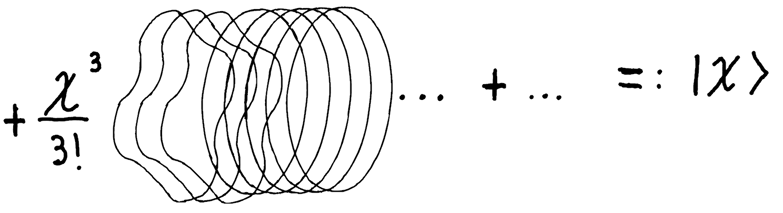
Original Contribution
Microstates
Simple class obtained by acting with a symmetry on the ground state. w=1, J⁺₋₁ only, one at a time.
18/25

Slide 65
Original Contribution
The parameter χ
Parameter χ: describes how many strings are excited
19/25

Slide 66
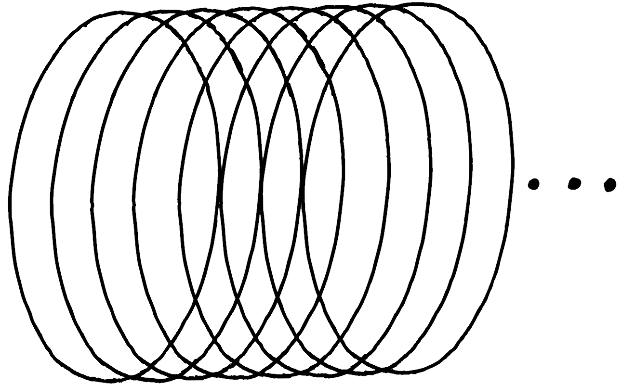

Original Contribution
The parameter χ
Parameter χ: describes how many strings are excited
χ=0
19/25

Slide 67
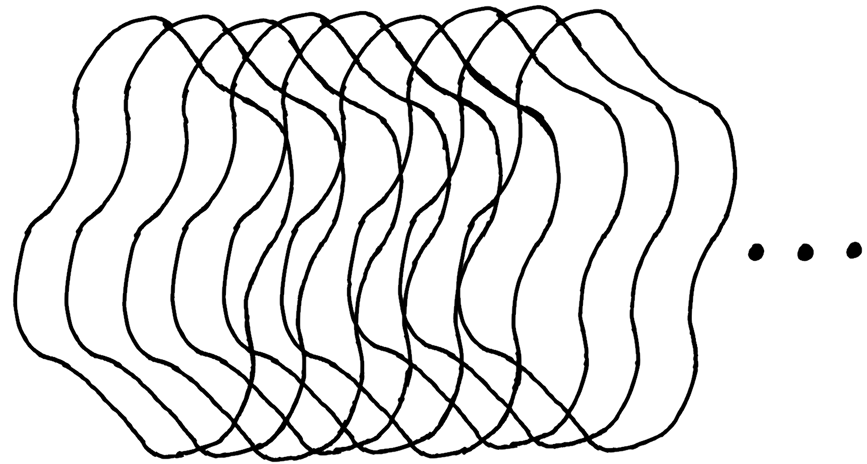
Original Contribution
The parameter χ
Parameter χ: describes how many strings are excited
χ=0
χ=π/2
[Stefano Giusto and Samir D. Mathur. Geometry of d1-d5-p bound states. Nuclear Physics
B, 729(1-2):203-220, Nov 2005.]
19/25

Slide 68
Original Contribution
The parameter χ
Parameter χ: describes how many strings are excited
χ=0
χ=π/2
Next step: w=1, J⁺_{-n} one at a time.
[Stefano Giusto and Samir D. Mathur. Geometry of d1-d5-p bound states. Nuclear Physics
B, 729(1-2):203-220, Nov 2005.]
19/25

Slide 69
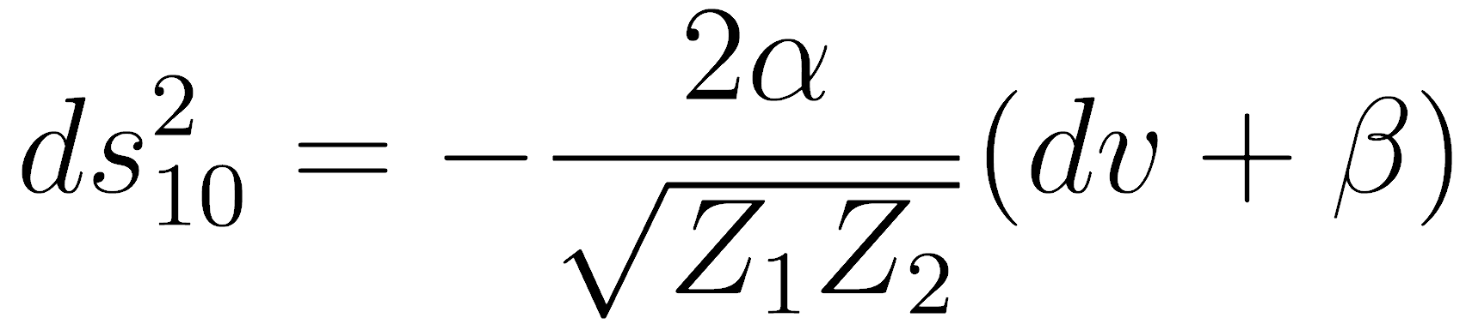
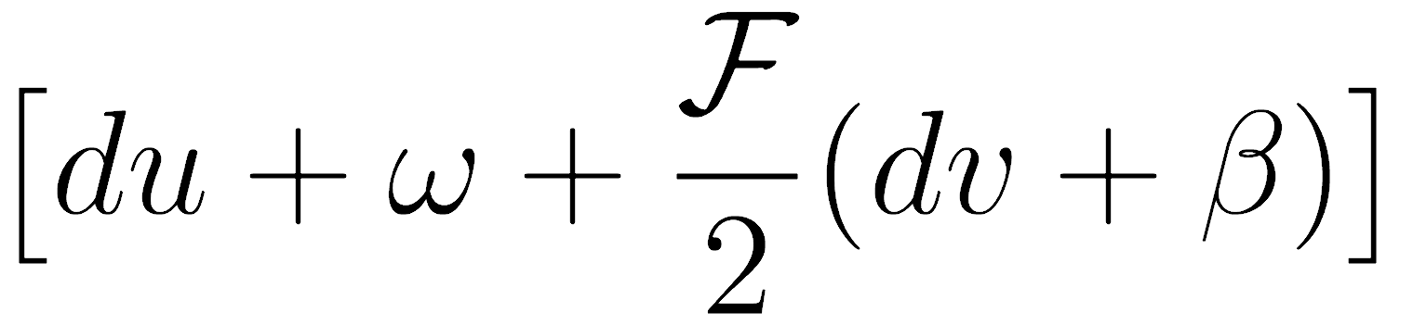
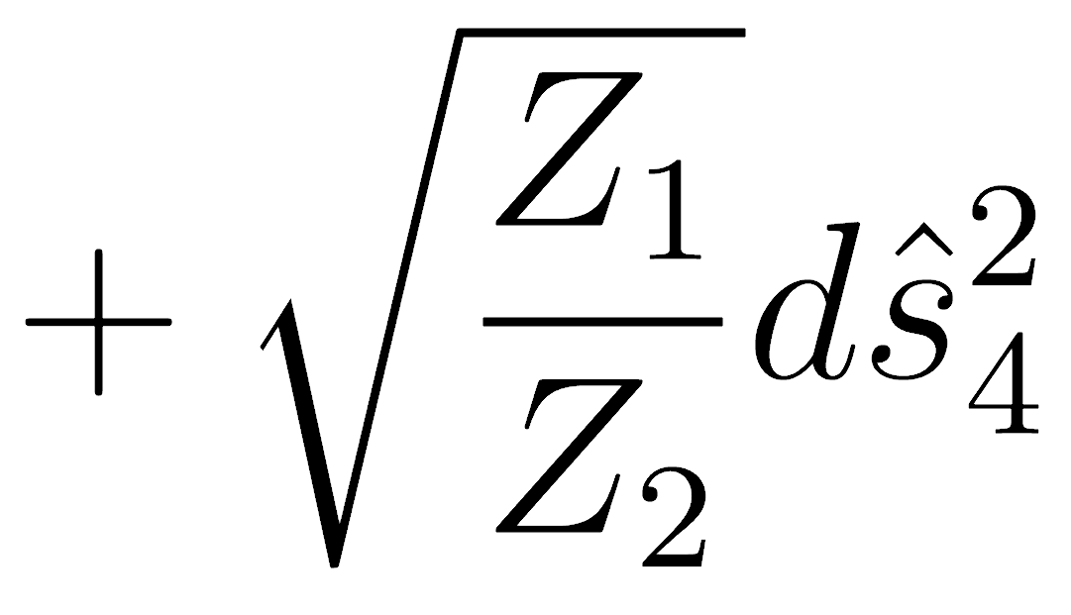
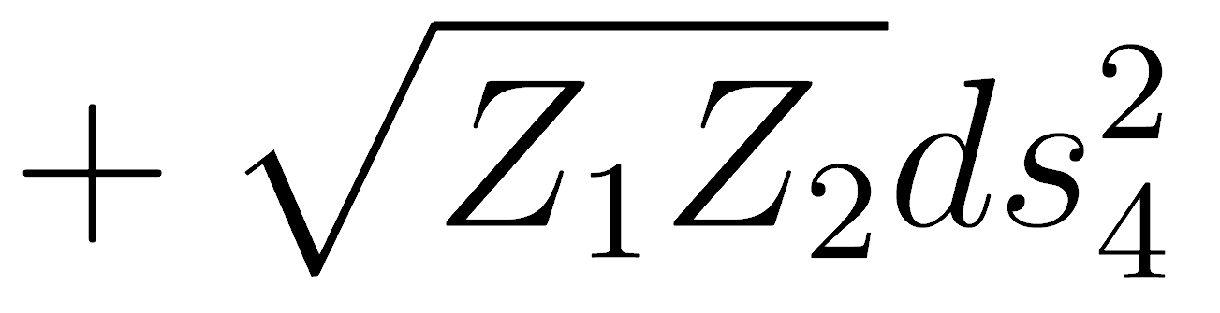
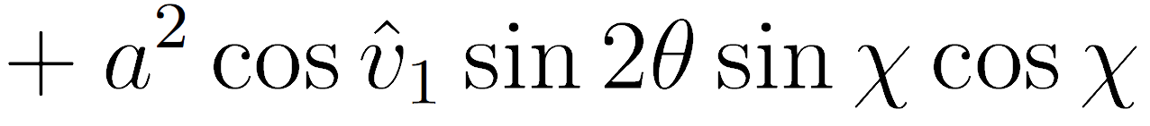
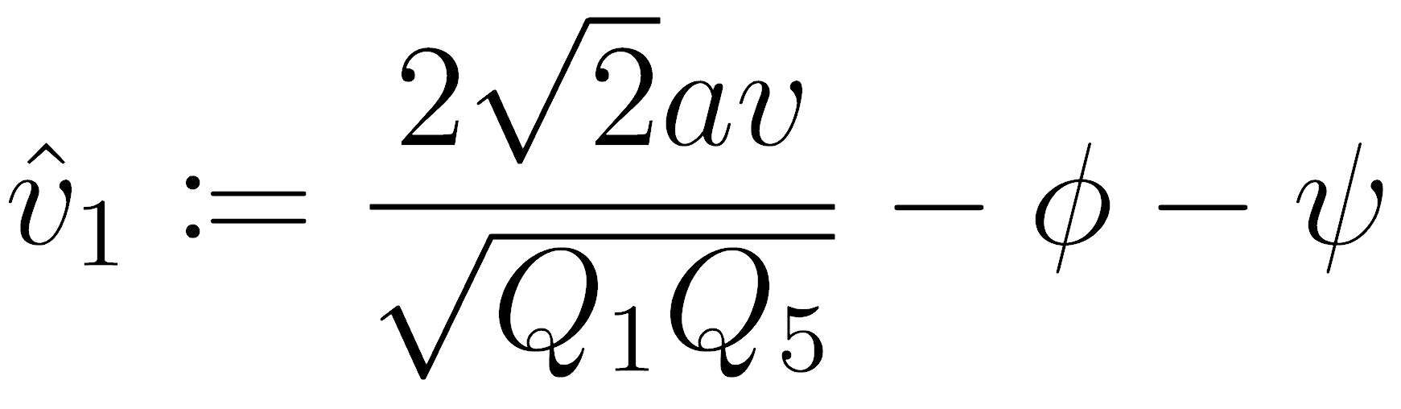
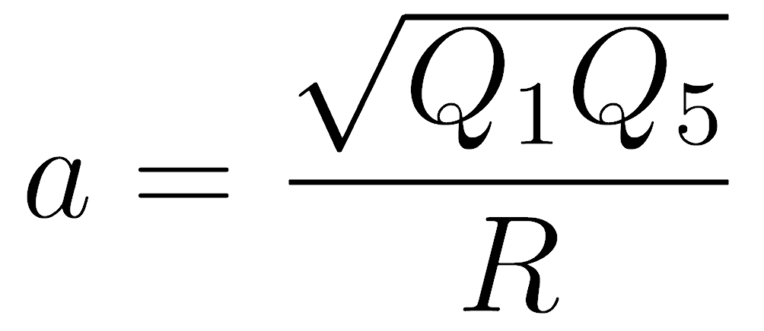
Original Contribution
Solution
Part of the solution for w=1,J⁺₋₁:
It is helpful to define
20/25

Slide 70
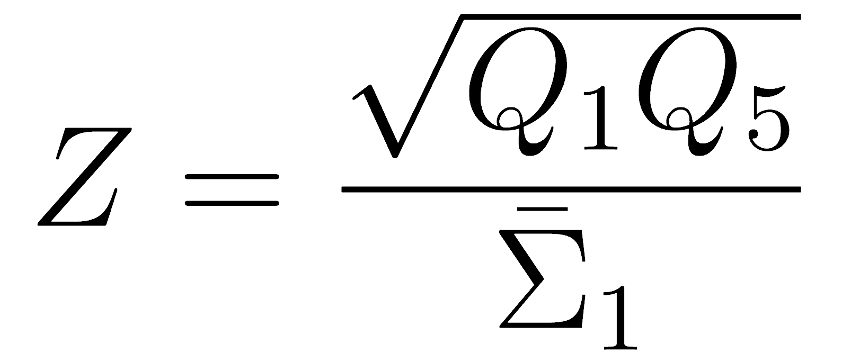
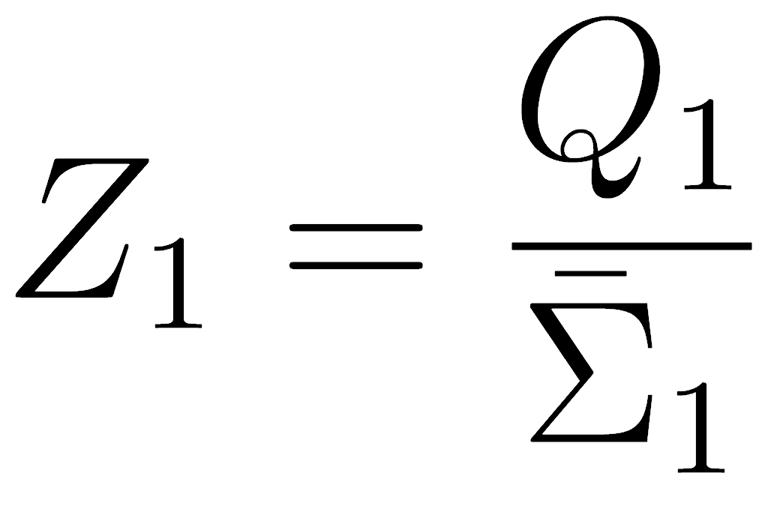
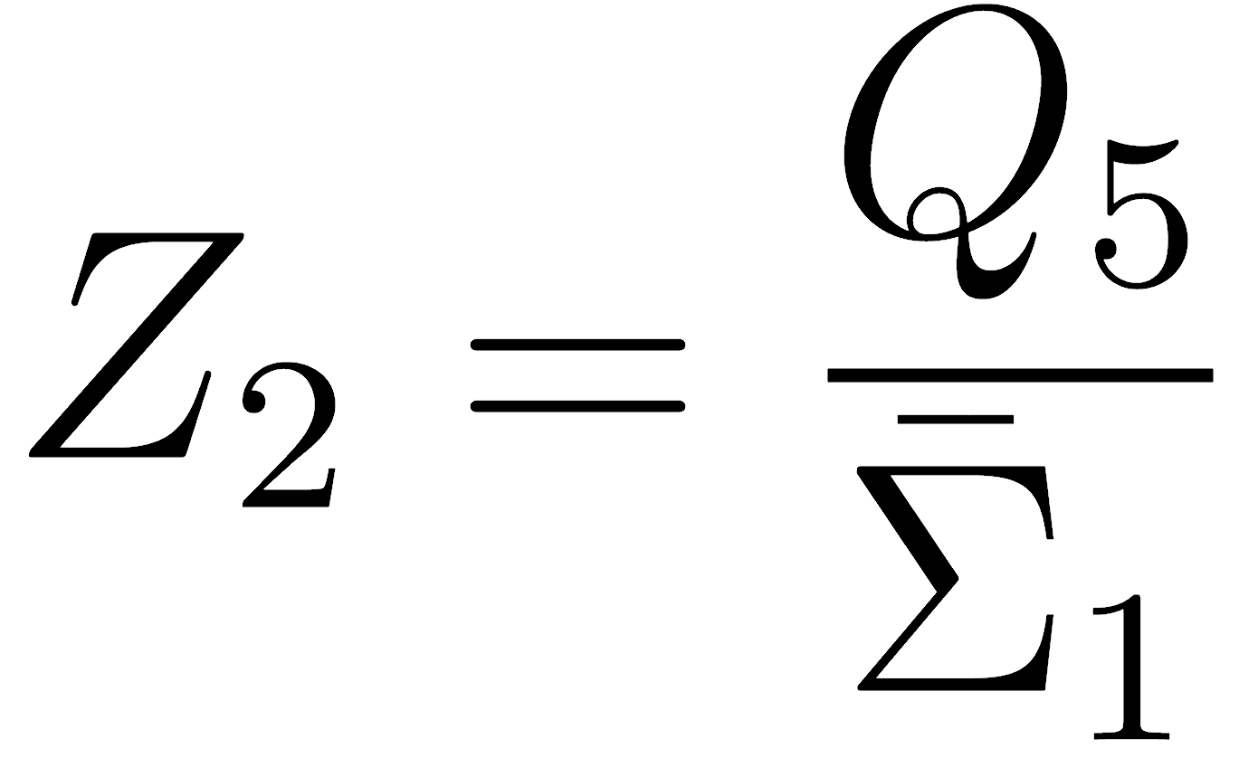
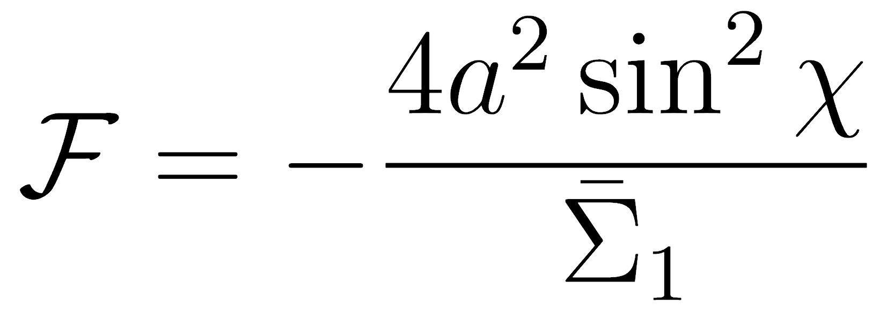
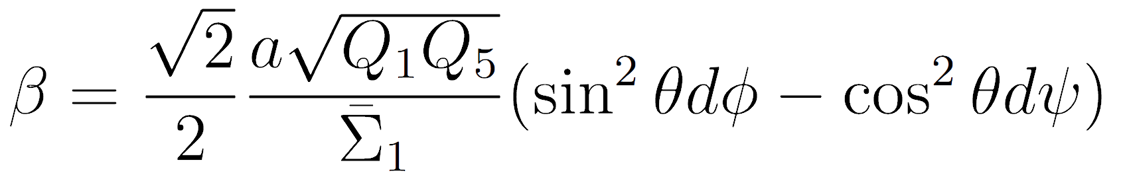
Original Contribution
Coefficients
The coefficients are:
α=1
21/25

Slide 71
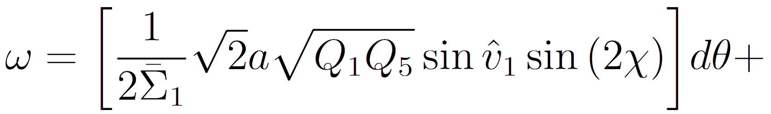
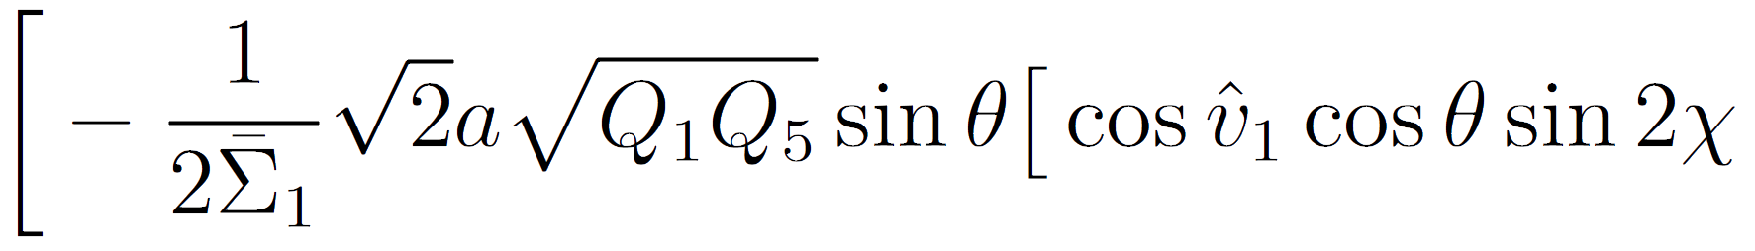
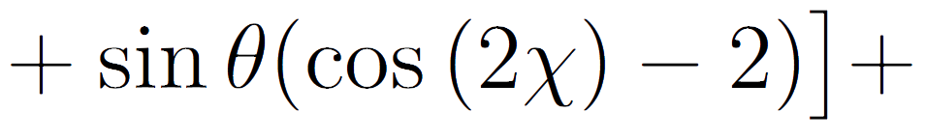
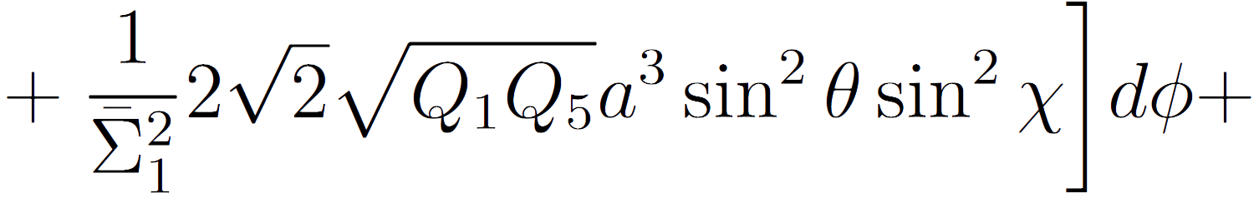
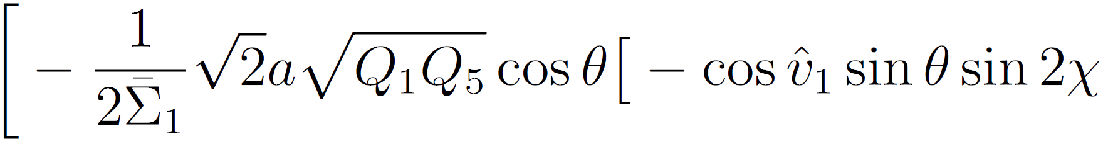
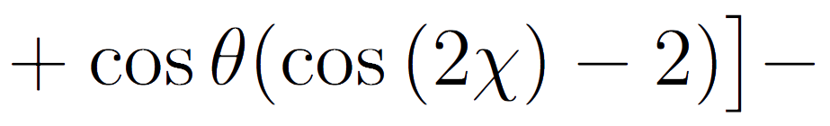
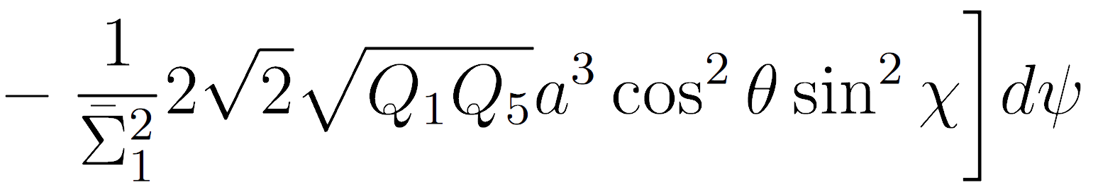
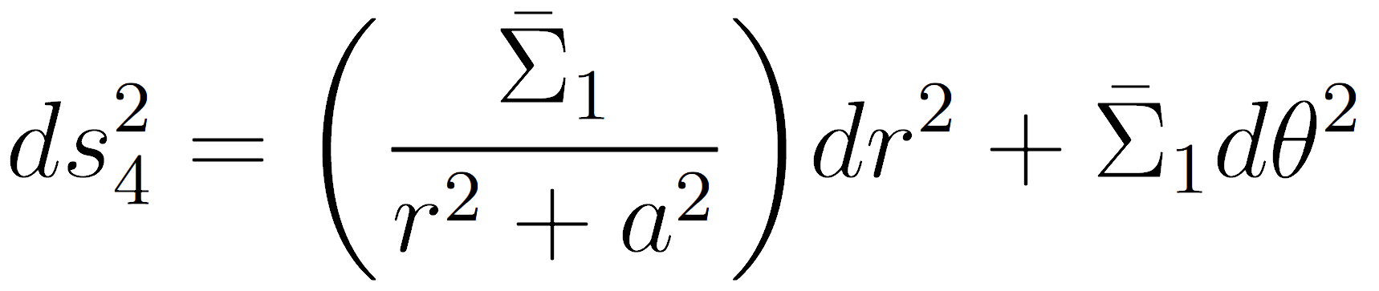
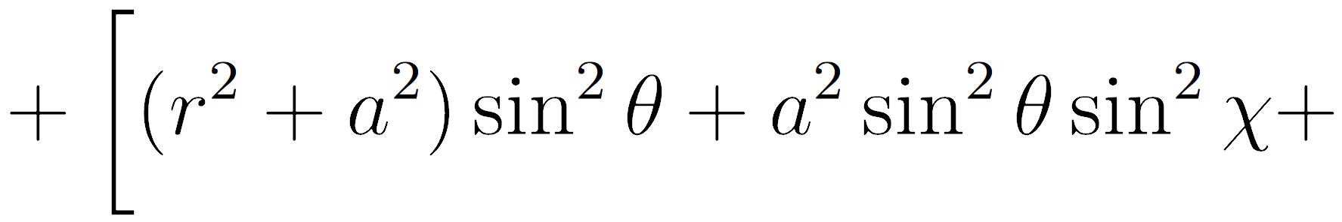
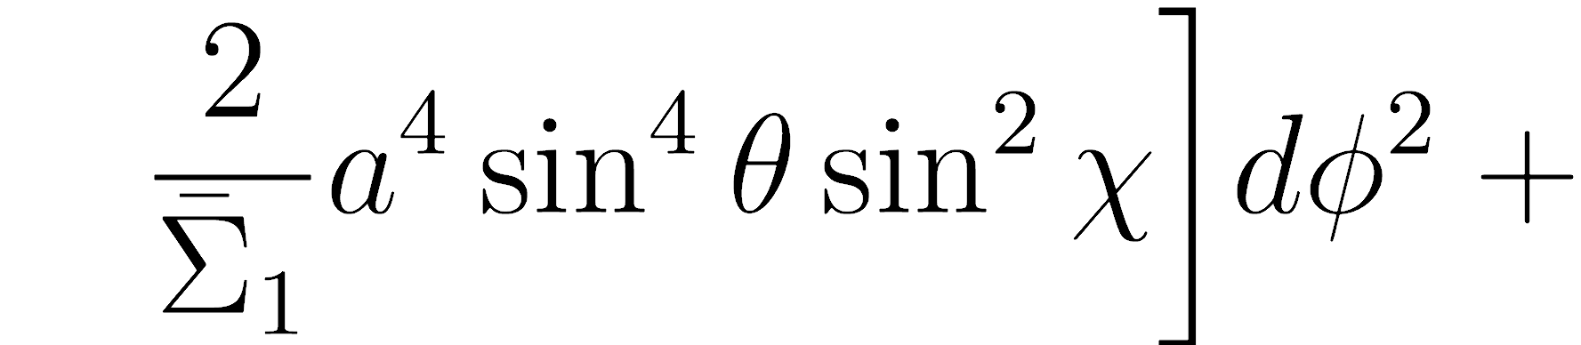
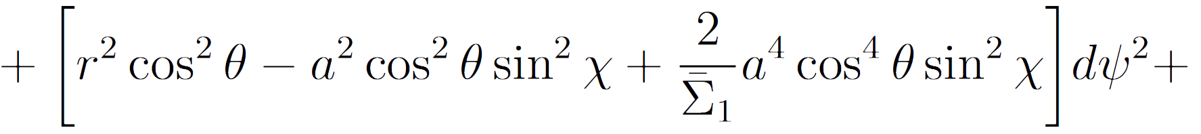
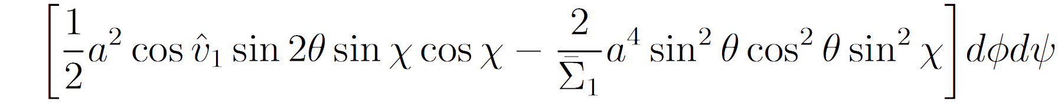
Original Contribution
Coefficients
22/25

Slide 72
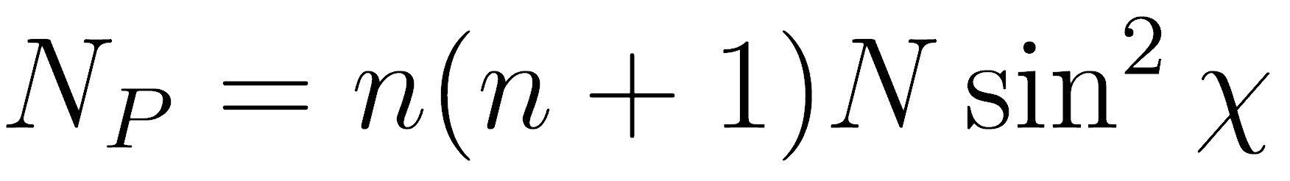
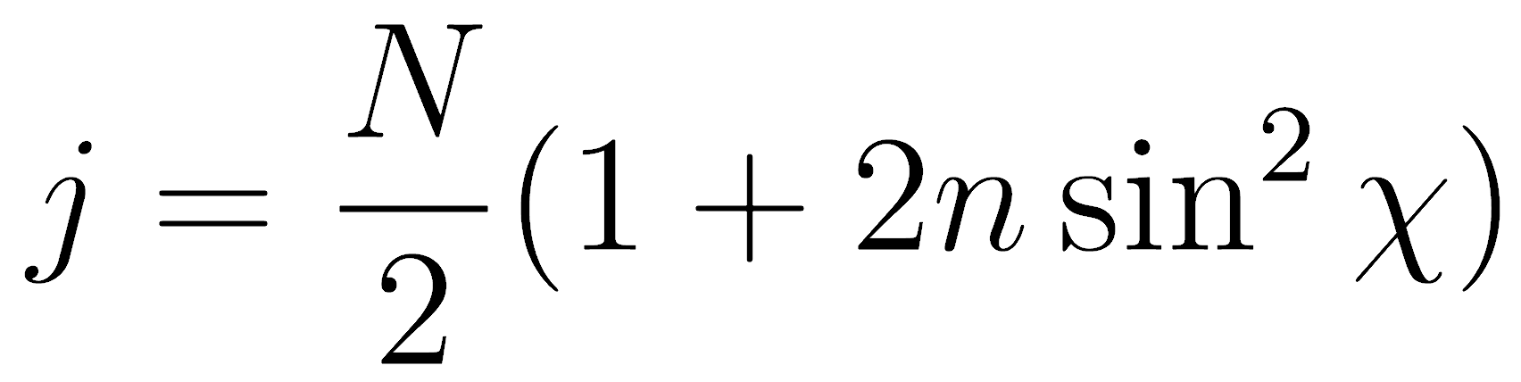
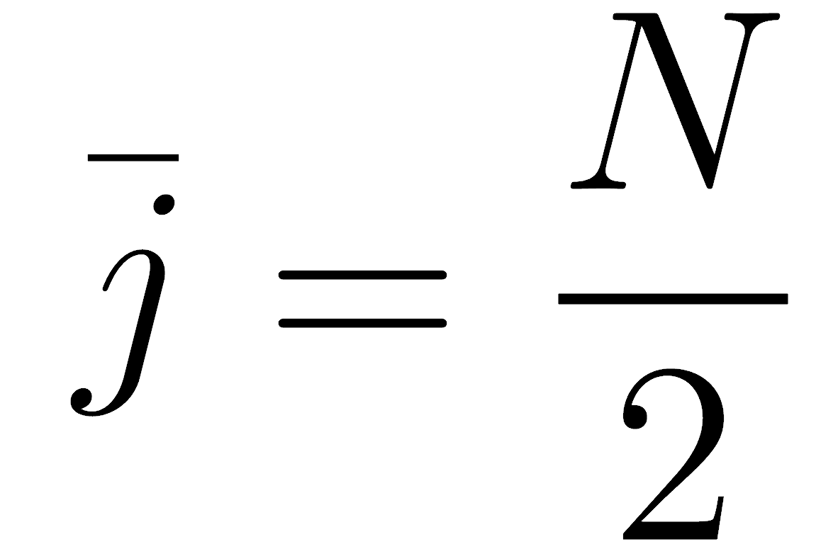
Original Contribution
Charges
23/25

Slide 73
Original Contribution
Charges
Gravity side: Large r behaviour of the solution
23/25

Slide 74
Original Contribution
Charges
Gravity side: Large r behaviour of the solution
CFT side: Mean value of the operators
23/25

Slide 75
Original Contribution
Charges
Gravity side: Large r behaviour of the solution
CFT side: Mean value of the operators
Nontrivial check of consistency + Confirms AdS/CFT
23/25

Slide 76
Future developments
More general microstates
These microstates are not typical
24/25

Slide 77
Future developments
More general microstates
These microstates are not typical
To do:
Find microstates not obtainable with coordinate transformations
Study w>1
24/25

Slide 78
Future developments
More general microstates
These microstates are not typical
To do:
Find microstates not obtainable with coordinate transformations
Study w>1
Next step: rewrite ds²₄ and generalize
24/25

Slide 79
Future developments
Future of the fuzzball
Open problems:
1) In what microstates are astrophysical black holes typically found?
25/25

Slide 80
Future developments
Future of the fuzzball
Open problems:
1) In what microstates are astrophysical black holes typically found?
2) When do fuzzballs produce observable deviations from a typical black hole?
25/25

Slide 81
Future developments
Future of the fuzzball
Open problems:
1) In what microstates are astrophysical black holes typically found?
2) When do fuzzballs produce observable deviations from a typical black hole?
3) How to describe 4D black holes?
25/25

Slide 82
Thank you for your attention!

